Slide 1
A FRAMEWORK
For Social and Emotional Approaches to Teaching and Learning
EDUC1199 ~ 19 August 2015

Slide 2
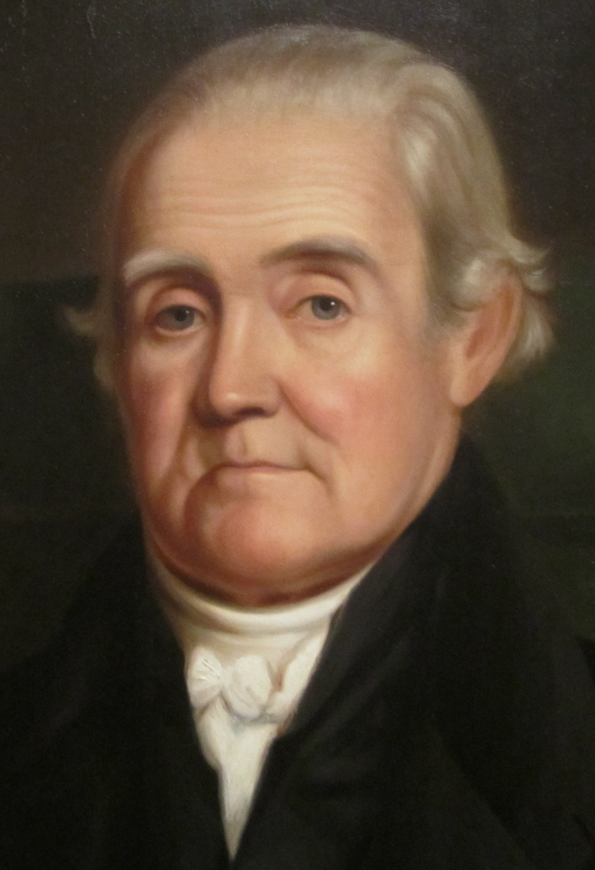
“The virtues of men are of more consequence to society than their abilities; and for this reason, the heart should be cultivated with more assiduity than the head.”
- Noah Webster, 1788

Slide 3

“…[E]xperience and research show that promoting social and emotional development in children is ‘the missing piece’ in efforts to reach the array of goals associated with improving schooling in the United States.”
(Elias et al., 1997)

Slide 4
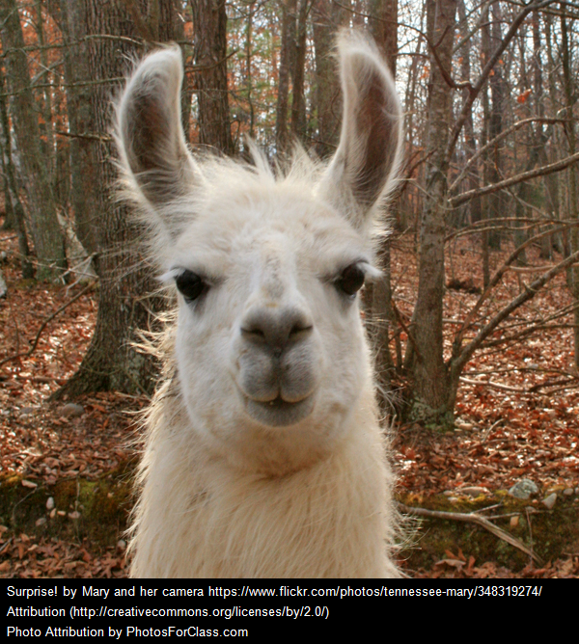
“…[T]he least successful substance abuse prevention programs are those that provide students information about the dangers of illicit drug use without helping them understand the social and emotional dimensions of peer pressure, stress, coping, honesty, and consequential thinking.”
(Elias et al., 1997)

Slide 5
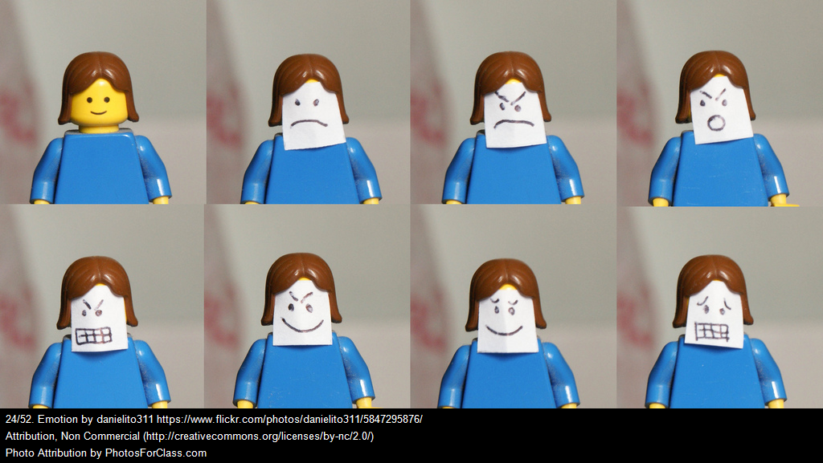
We carry our emotions with us…

Slide 6
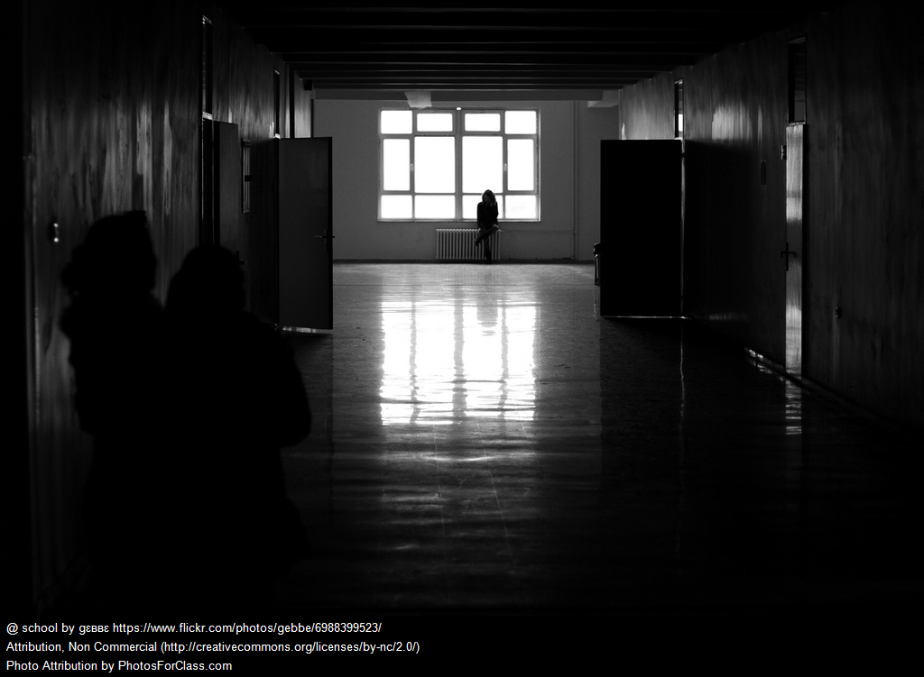
…And emotions influence teaching and learning.

Slide 7
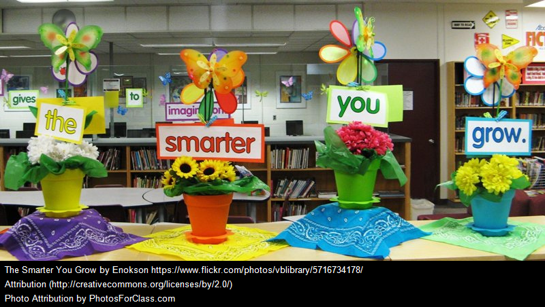
School is a place to practice, learn, and grow.

Slide 8

We want learners to practice, learn, and grow socially and emotionally.

Slide 9
A Convergence of Many Branches
The Social-Emotional Family Tree
Character
Grit
Growth Mindset
Noncognitive Traits and Habits
School Reform Movements
21st Century Skills
Cognitive and Social Psychology
Social and Emotional Skills
Soft Skills
Other Traditions
Mindfulness
Restorative Justice

Slide 10
“It’s a different way of being smart.”
-Daniel Goleman (1995)

Slide 11

Focusing on a Framework

Slide 12
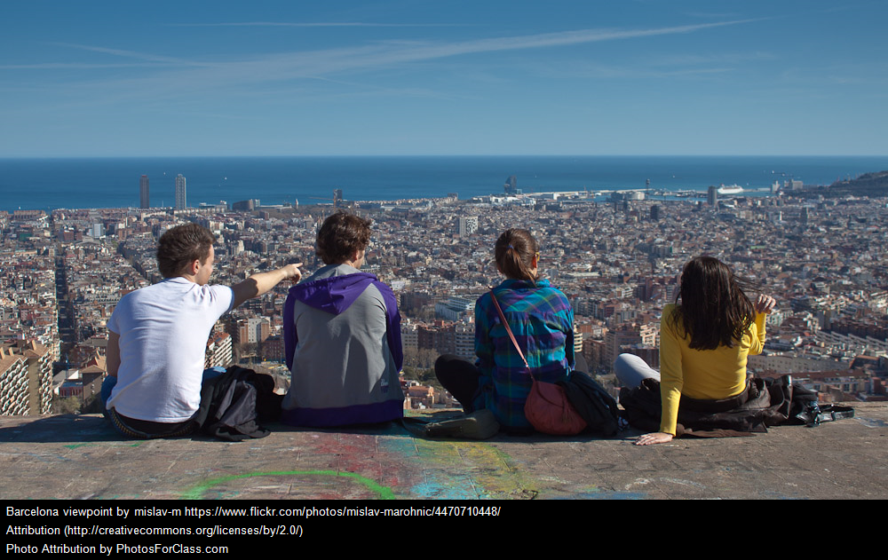
Frameworks as Working Through Complexity
FRAMEWORKS HELP US pay attention to specific details and make sense of these details within the context of the whole. They give us boundaries for our work when reality is complicated, and help us to make connections between different parts.

Slide 13
Our Focusing Framework
Skills
Attitudes and Values
Content
Self-Management
Problem Solving and Decision Making
Communication
About Self
About Others
About Tasks
Self/Health
Relationships
School/Community
New Haven Social Development Curriculum

Slide 14
Focusing on Skills
Skills
Attitudes and Values
Content
Self-Management
Problem Solving and Decision Making
Communication
About Self
About Others
About Tasks
Self/Health
Relationships
School/Community
New Haven Social Development Curriculum

Slide 15
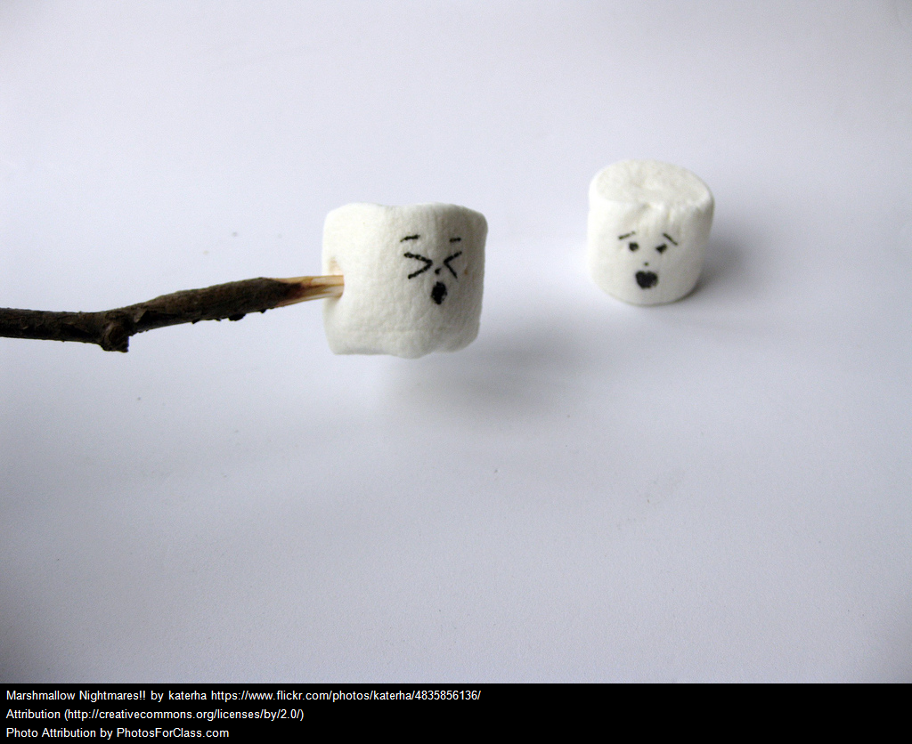
Focusing on Skills
Students can learn and get better at utilizing specific strategies and practices at appropriate times. Learning to apply these strategies, practices, and skills at the right time can benefit the learner personally and the classroom community more generally in the short term and the long term.

Slide 16
Focusing on Attitudes and Values
Skills
Attitudes and Values
Content
Self-Management
Problem Solving and Decision Making
Communication
About Self
About Others
About Tasks
Self/Health
Relationships
School/Community
New Haven Social Development Curriculum

Slide 17
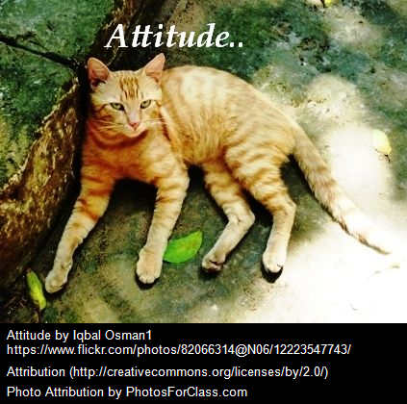
Focusing on Attitudes and Values
Attitudes and values are what direct our attention and help us build meaning in our work. We enter the classroom with attitudes and values towards ourselves, others, and the work we do. These attitudes and values are not static; they can change with intentional effort and even the occasional nudge.

Slide 18
Focusing on Content
Skills
Attitudes and Values
Content
Self-Management
Problem Solving and Decision Making
Communication
About Self
About Others
About Tasks
Self/Health
Relationships
School/Community
New Haven Social Development Curriculum

Slide 19

Focusing on Content
Content, or knowledge, serves as the building blocks for a social and emotional approach to teaching and learning. Deeply understanding the connections between self, health, relationships, and community fosters the development of skills, practices, attitudes, and values.

Slide 20
The Role of Caring
Caring is central to the shaping of relationships that are meaningful, supportive, rewarding, and productive. Caring happens when children sense that the adults in their lives think they are important and when they understand that they will be accepted and respected, regardless of any particular talents they have.
(Elias et al., 1997)

Slide 21
The Role of Caring
Caring is a product of a community that deems all of its members to be important, believes everyone has something to contribute, and acknowledges that everyone counts. We work better when we care and when we are cared about, and so do students.
(Elias et al., 1997)

